Slide 1
Android Games Analysis – Why Does my playtime reduce my talk time?
Team – Hunger-Games
Milind Gokhale
Renuka Deshmukh

Slide 2


Motivation
Games => 16% of the total time spent on mobile apps in US. _{COMSCORE}
Appeal to diverse group of audience
Advent of modern technology and higher configuration => innovative games
Mobile game revenues will reach $28.9Bn by 2016, up 38% from 2014.

Slide 3
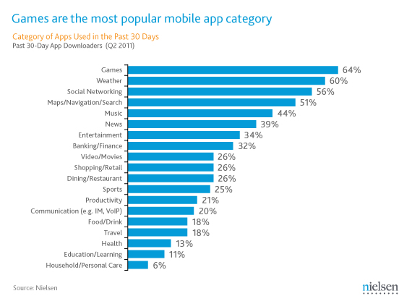
Most popular mobile app category

Slide 4
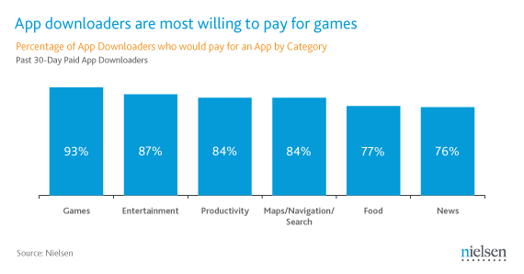
Will you pay to purchase mobile games?

Slide 5

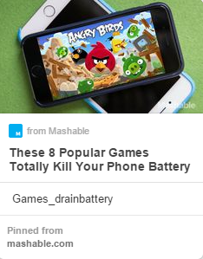

However…???!!
http://venturebeat.com/2014/08/26/heres-what-candy-crush-saga-and-kim-kardashian-are-doing-to-your-phones-storage-and-battery-life/
http://mashable.com/2014/10/01/games-battery-draining/
http://www.verizonwireless.com/support/high-risk-android-apps/

Slide 6
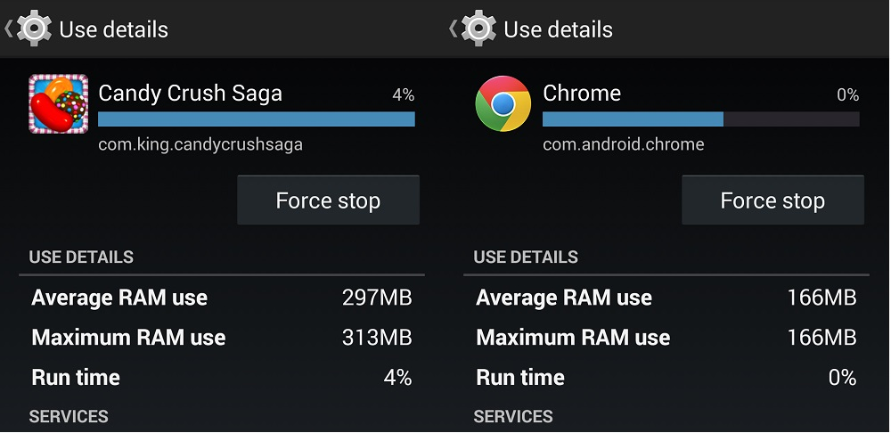
Bad User Experience
High Memory (RAM) usage

Slide 7
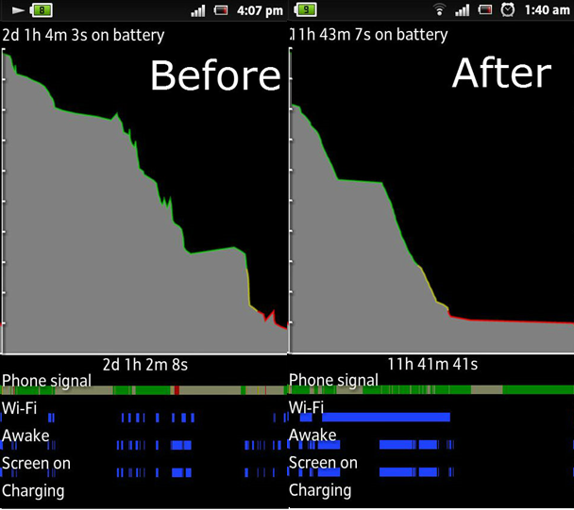
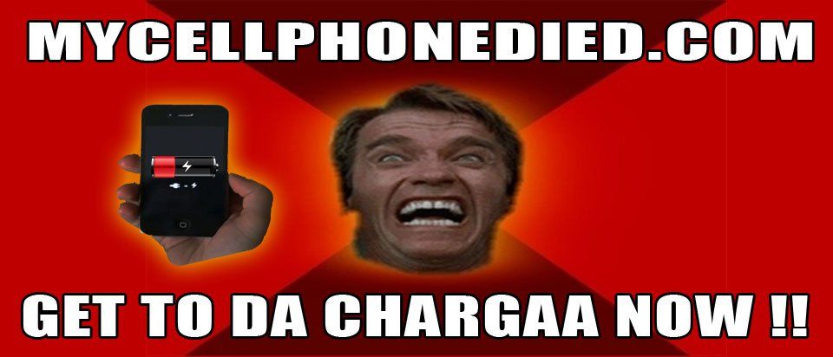
Bad User Experience
High Battery consumption

Slide 8
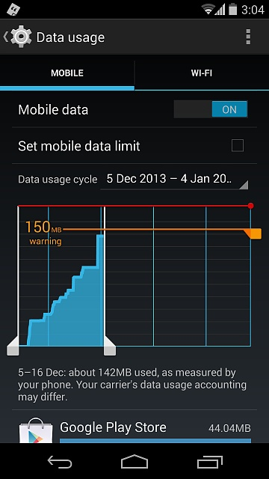

Bad User Experience
Unexpected High data usage

Slide 9
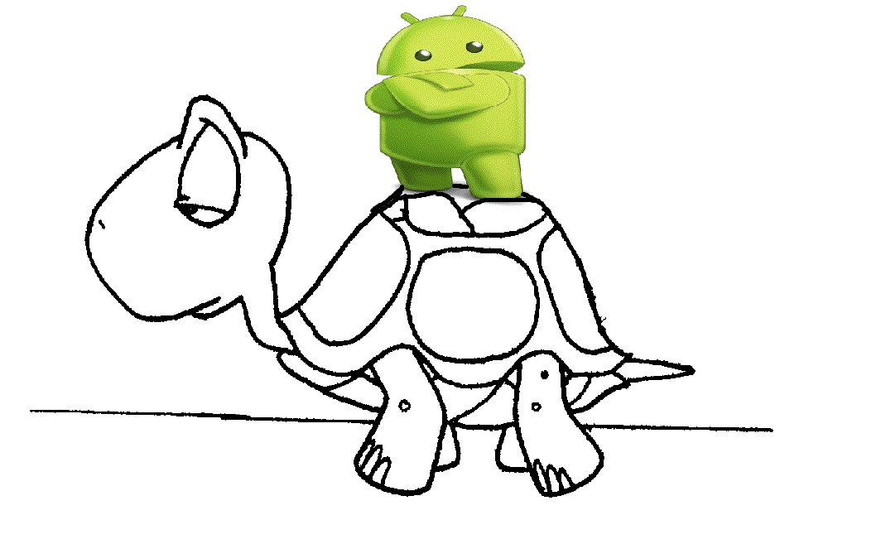

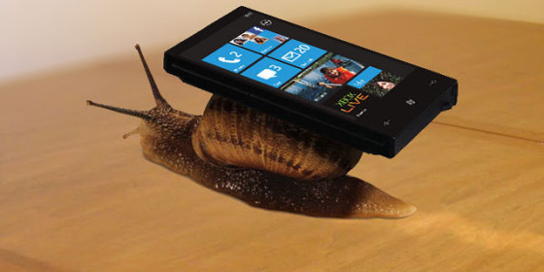
Bad User Experience
Performance Slowdown

Slide 10
Project Idea
What can be done?
Trying to find the root cause of inefficiencies in online mobile games in terms of memory usage, data usage and performance.
Approach
Data Collection
Analysis
Recommendation

Slide 11
Challenges
Time Constraint
Focused to particular cluster of mobile gamers within students from IUB.
Data collection and user availability
Identify potential set of gamers to play these games for the purpose of our study.
Data Isolation
Allot timeslots for tests with only game running on device
Collect two sets of data with and without gameplay and take the difference of the two sets
High bandwidth data usage collection
Acquire a SIM with unlimited data plan for the study and execute multiple runs of games on phones using the SIM.

Slide 12
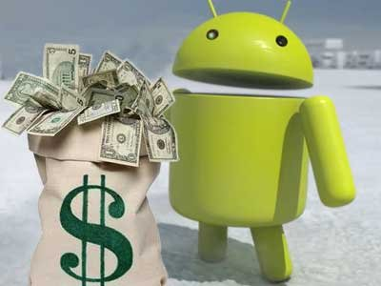

End goal
Industry perspective
Better games and efficient resource consumption
Increase in games usage and revenues
End-user perspective
Controlled data usage
Better performance
Better battery life

Slide 13
Timeline
Feb 13, 2015 – Feb 20, 2015: Design
Identifying test subjects.
Initial Design, Tools and installations.
Games finalization
Hardware acquisition (SIM and phones if required)
Feb 21, 2015 – Mar 20, 2015: Implementation
Data Collection Phase
Mar 21, 2015 – Apr 10, 2015: Evaluation
Data Analysis and Recommendation
Apr 11, 2015 – Apr 30, 2015: Project Report

Slide 14
Thank you
References
"Games Account for 16% of the Total Time Spent on Mobile Apps in the US." (comScore). Accessed February 14, 2015. http://www.factbrowser.com/facts/15662/.
"Mobile Game Revenue Will Reach $28.9B by 2016, up 38% from 2014." (Juniper Research). Accessed February 14, 2015. http://www.factbrowser.com/facts/15109/.
Schroeder, Stan. "Mobile Games Dominate Smartphone App Usage [STATS]." Accessed February 14, 2015. http://mashable.com/2011/07/07/smartphone-mobile-games/.
"High Risk Android™ Apps." High Risk Android Apps. Accessed February 14, 2015. http://www.verizonwireless.com/support/high-risk-android-apps/.

